Slide 1

Medical Wristband Body Temperature Monitor
EERI474 – Conceptual Design Presentation
JH van Dyk
30254906

Slide 2

This presentation will cover
The design concept.
A functional analysis of the system.
An architectural synthesis of the system.
The scope of the design.
Resources needed to realise the design.
Possible stumbling blocks.
https://pi.tedcdn.com/r/talkstar-assets.s3.amazonaws.com/production/playlists/playlist_127/6459afd3-4c02-41c4-8d97-1417ab709d38/design_legend_FB.jpg?quality=89&w=800

Slide 3
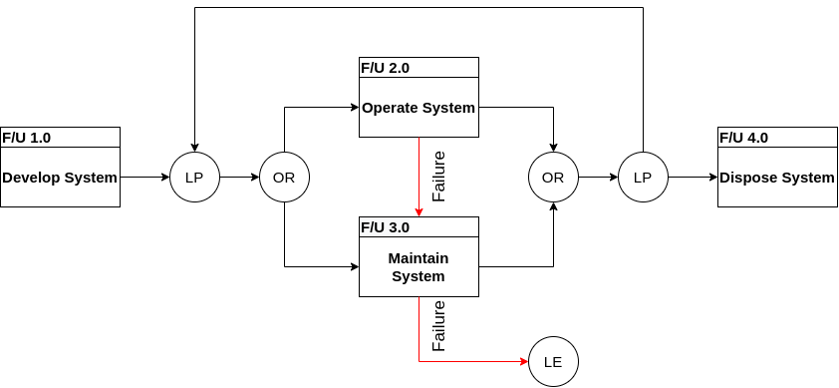
Functional Analysis
System life cycle

Slide 4
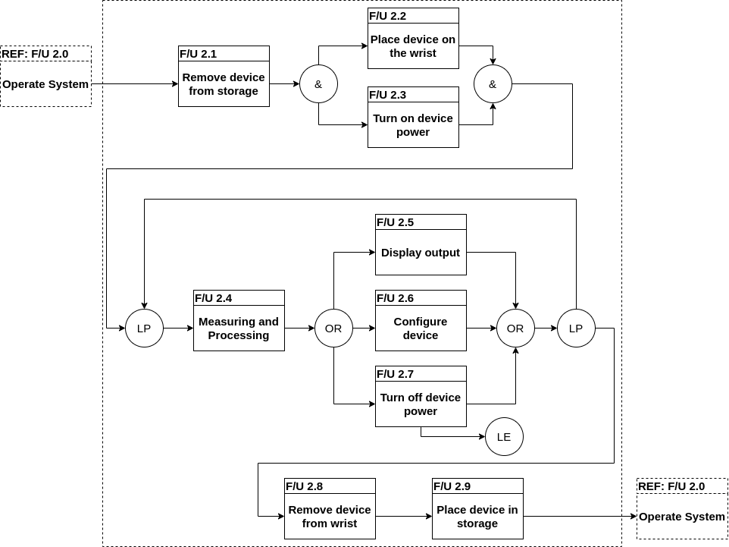
Functional Analysis – Operate system

Slide 5
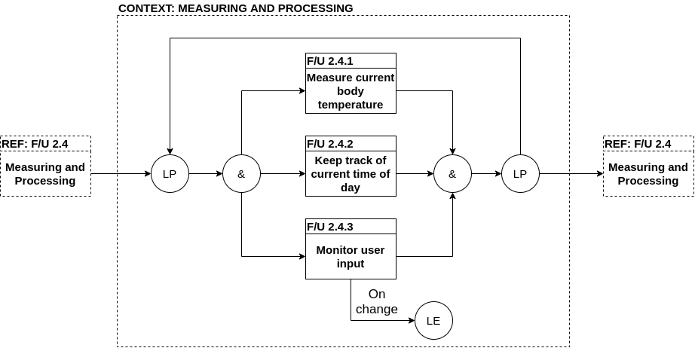
Functional Analysis – Measuring and Processing

Slide 6
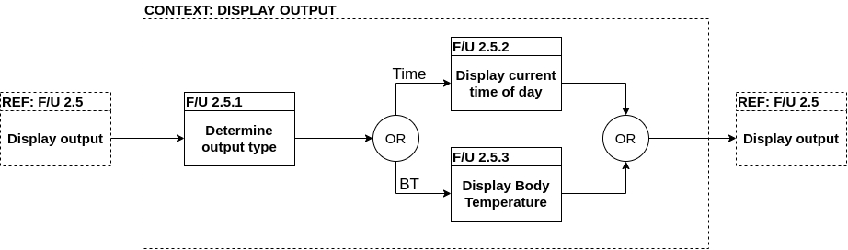
Functional Analysis – Display output

Slide 7
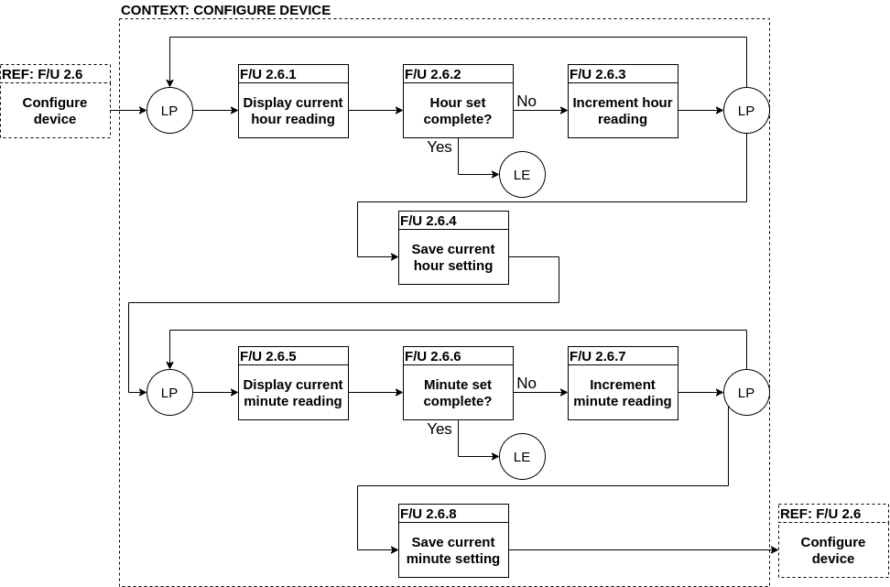
Functional Analysis – Configure device

Slide 8
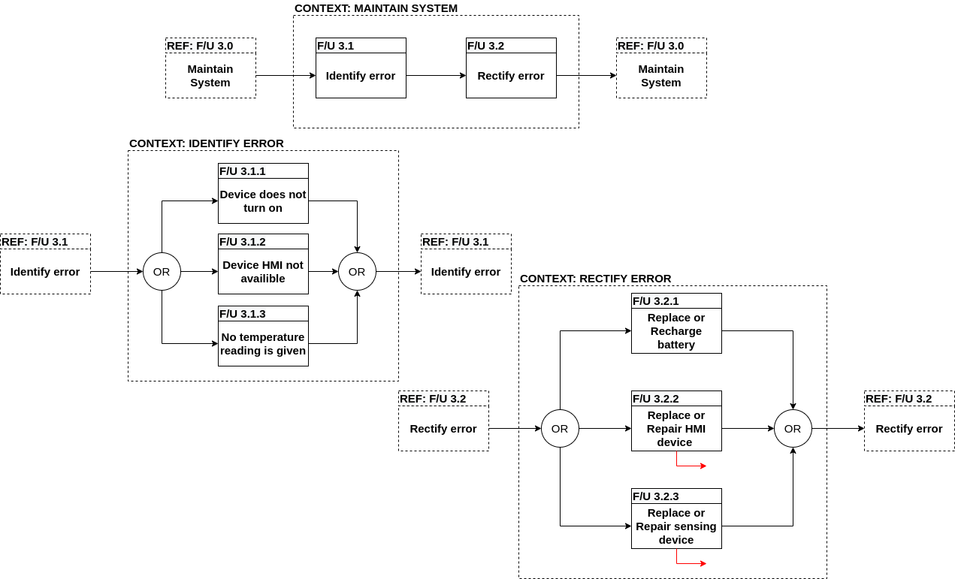
Functional Analysis – Maintain System

Slide 9
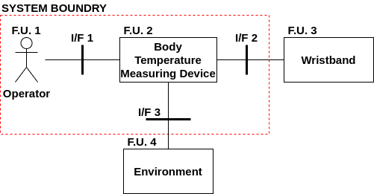
Architectural Synthesis
System architecture

Slide 10
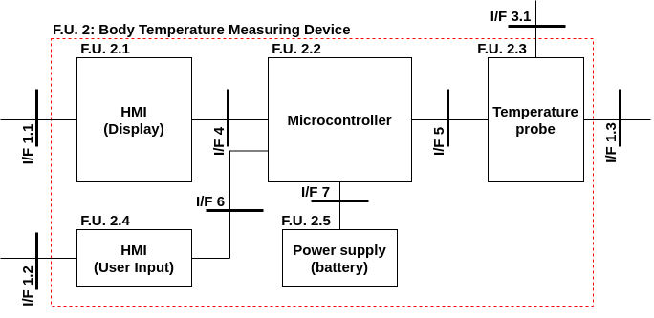
Architectural Synthesis
Physical Architecture

Slide 11
Resources needed
Microcontroller
8bit, 16bit
Display
7 segment, LCD
User input
Button
Power supply – battery
Either rechargeable or non-rechargeable
Temperature probe
Thermistor, RTD, Infrared

Slide 12
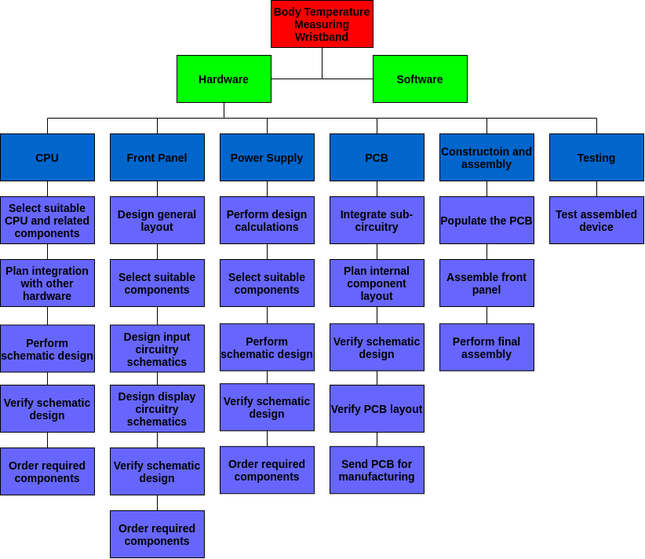
Scope of the design

Slide 13

Possible stumbling blocks
https://microgridknowledge.com/wp-content/uploads/2018/05/stumbling-block-72.jpg
Body temperature reading from surface temperature reading.
Environment temperature will influence the measured surface (skin) temperature.
Size of the designed product.
Size of the final product must be relatively small.
Energy usage.
Battery operated; energy usage will influence battery life.

